Slide 1
Software Work Samples
Soheil Ramezanzadeh Lamso
soheillamso@gmail.com

Slide 2
Contents
Desoft (PERSONAL PROFILE)
Nwms (Warehouse management software)
Ibaar BI (Intelligent cargo transportation system )
Bar24 ibaar (BOL system)
Track (Project management software)
Modis (Capital management software - web)
Modis (Capital management software - windows)
Windows application License Activator
Eyeglass store application

Slide 3
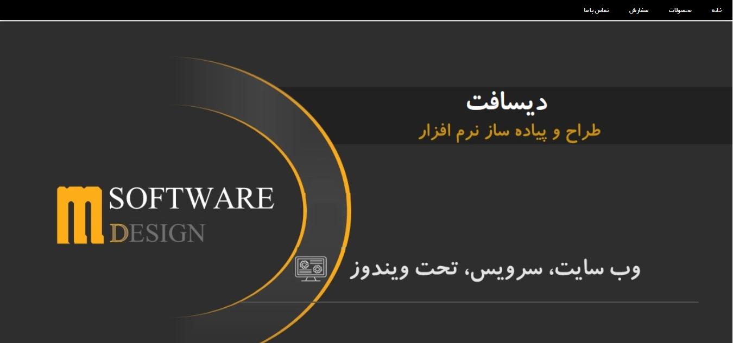
desoft.ir
(PERSONAL PROFILE)

Slide 4
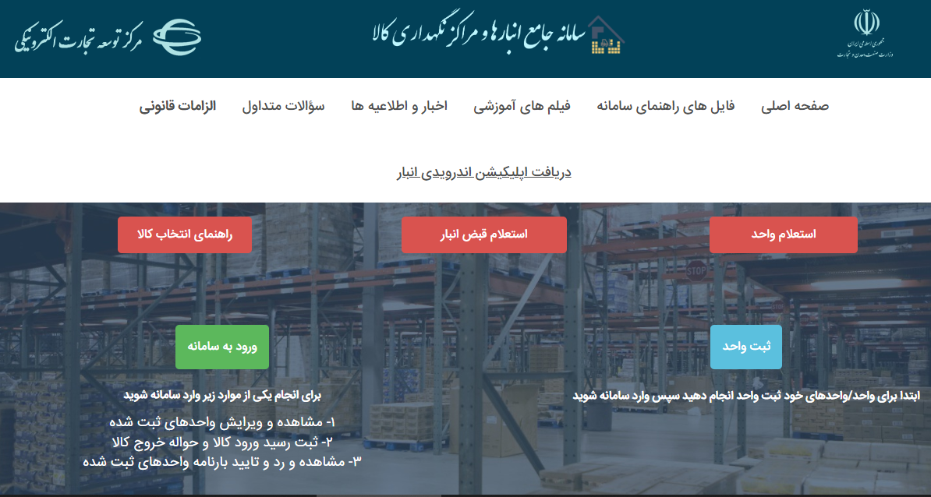
1
nwms.ir
(Warehouse management software)

Slide 5
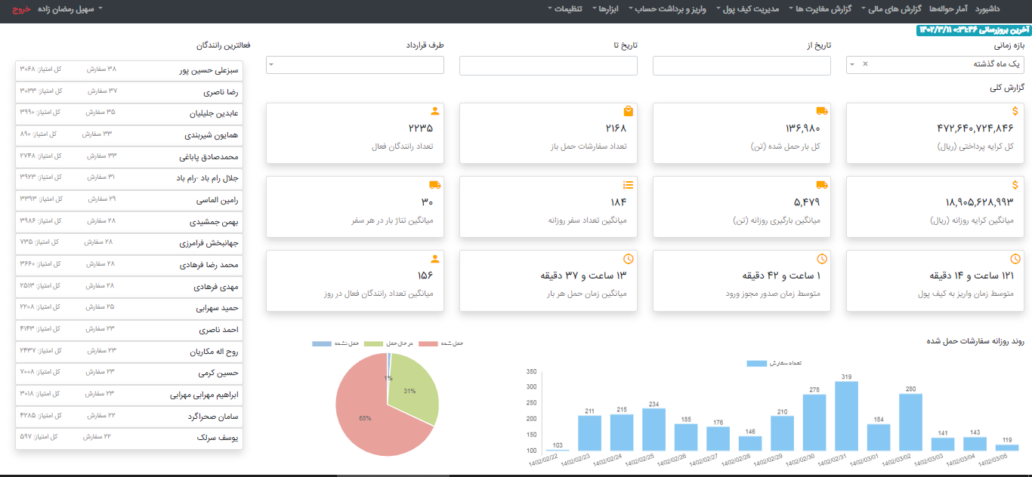
2
bi.ibaar.ir
(Intelligent cargo transportation system )

Slide 6
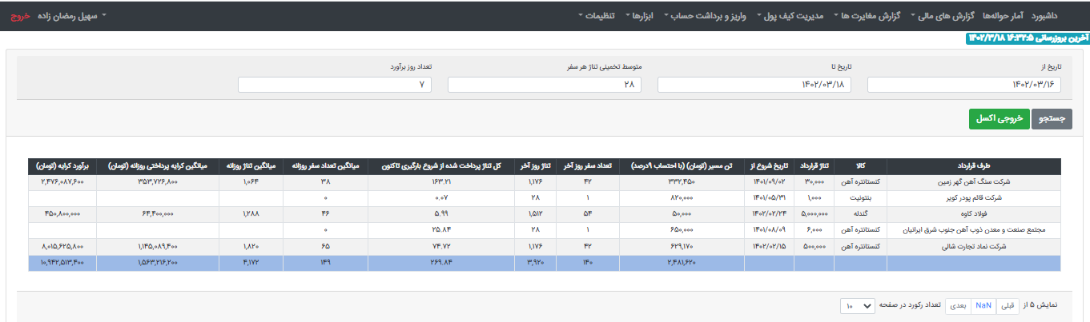
2

Slide 7
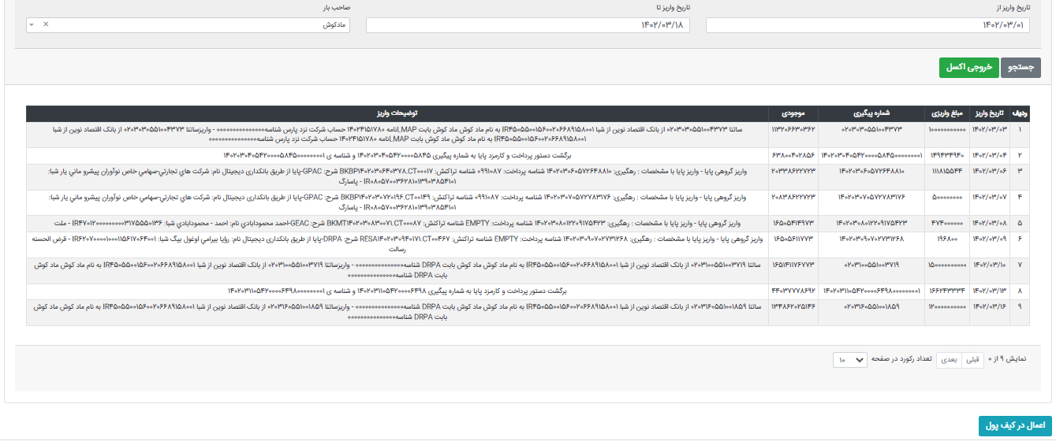
2

Slide 8
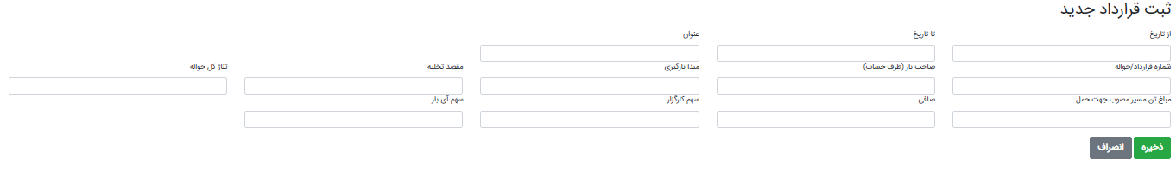
2

Slide 9
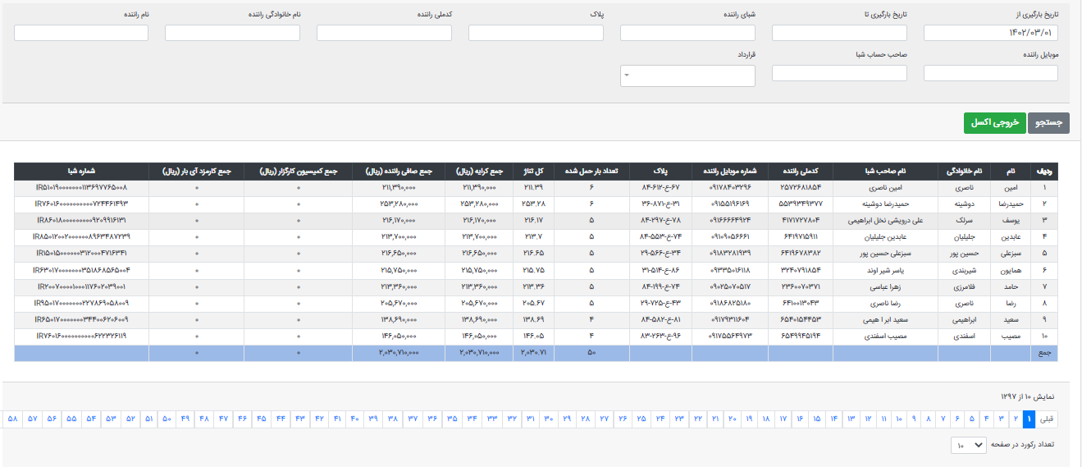
2

Slide 10
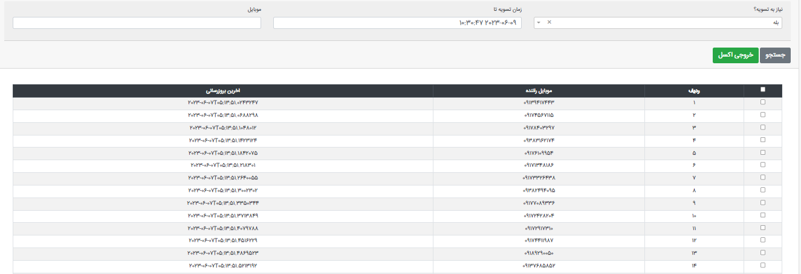
2

Slide 11
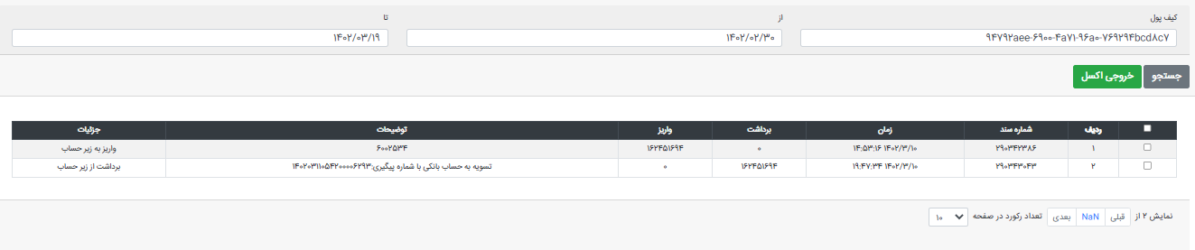
2

Slide 12
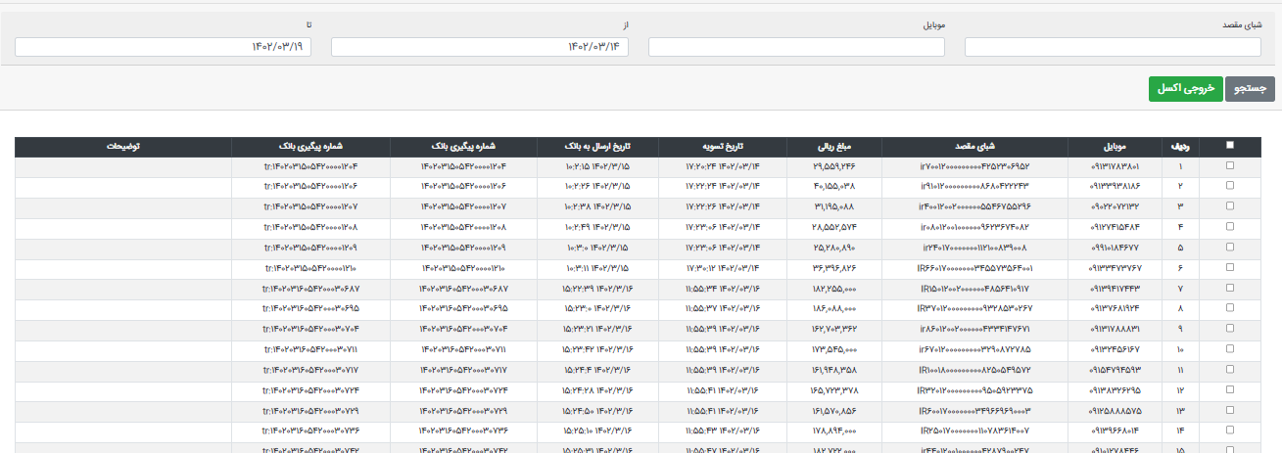
2

Slide 13
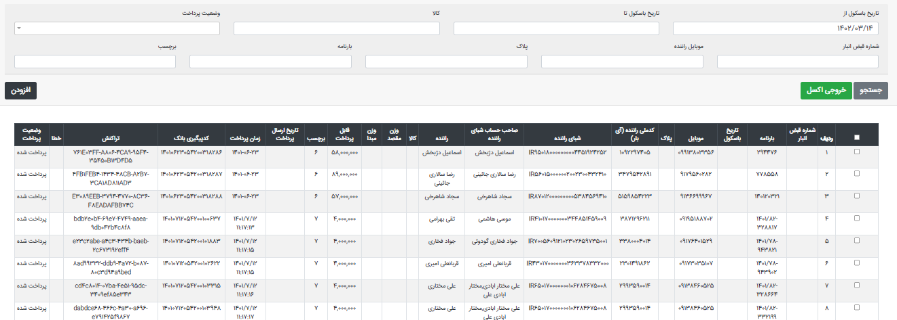
2

Slide 14
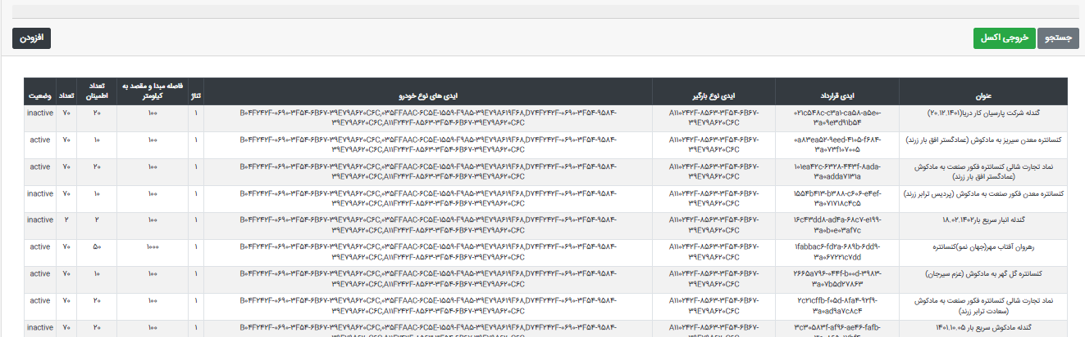
2

Slide 15
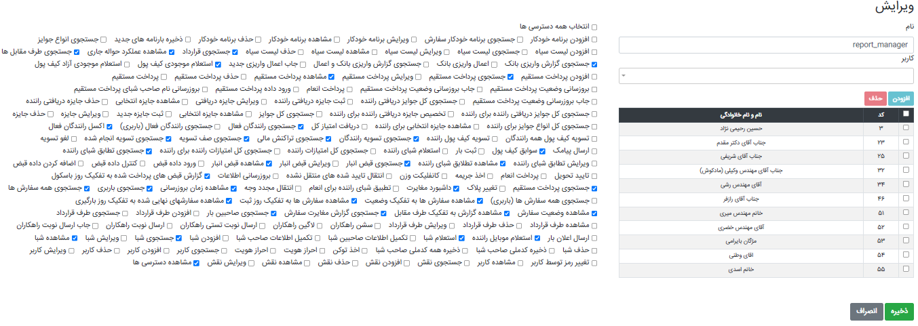
2

Slide 16
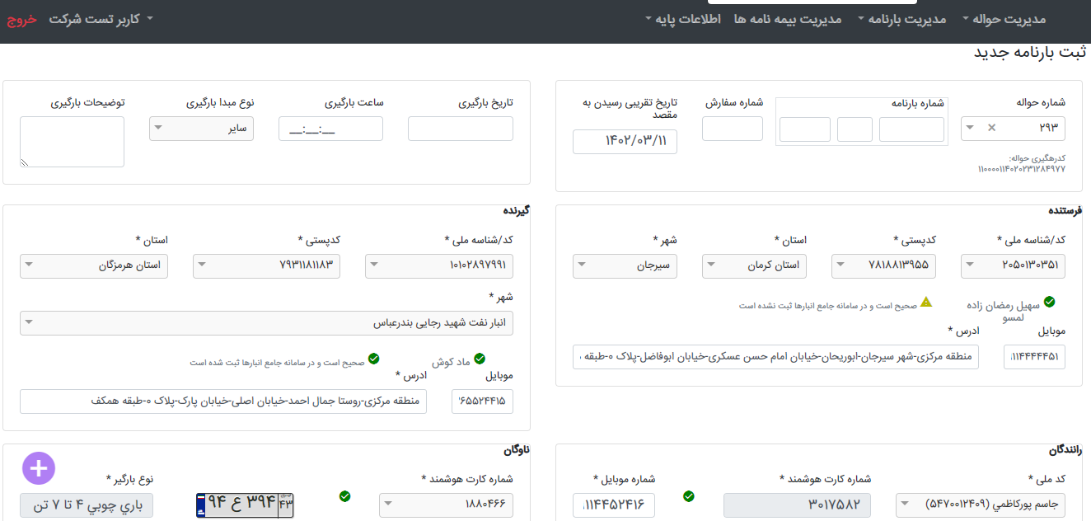
3
bar24.ibaar.ir
(BOL system)

Slide 17
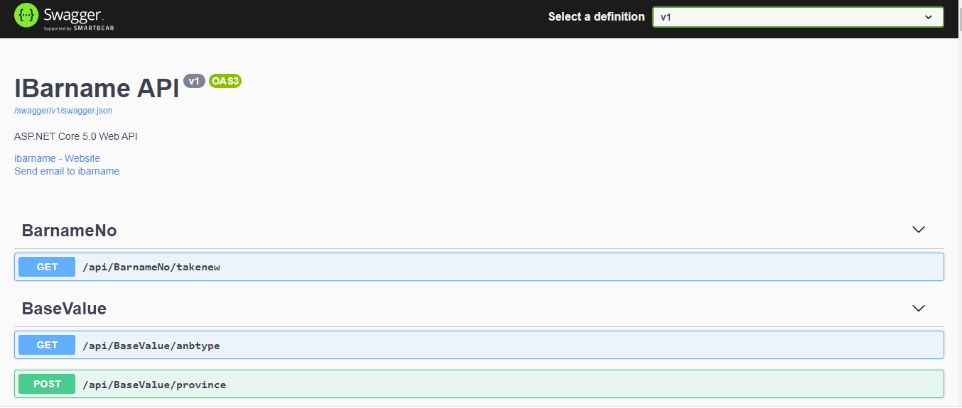
3

Slide 18
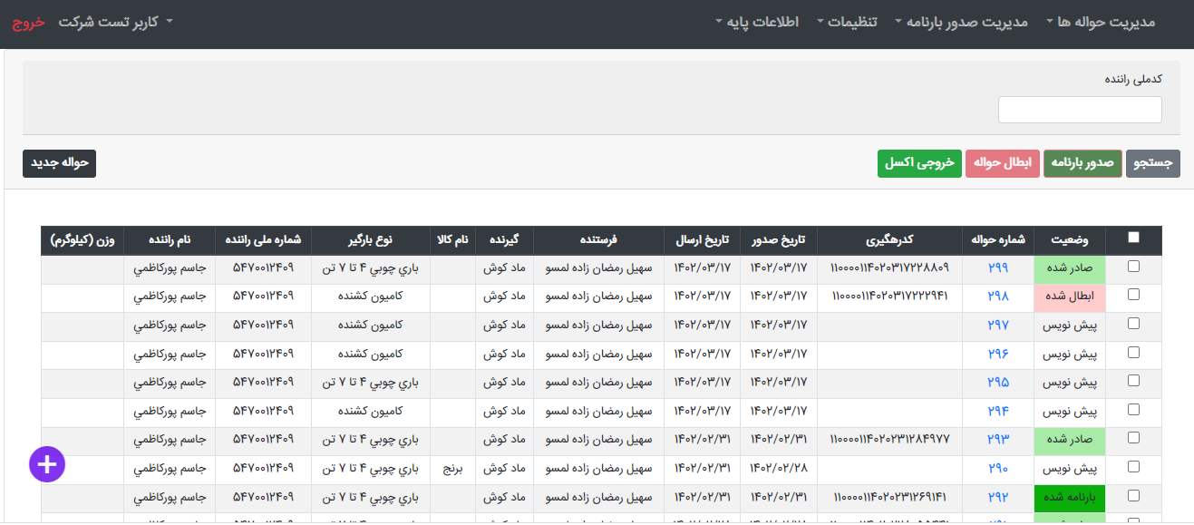
3

Slide 19
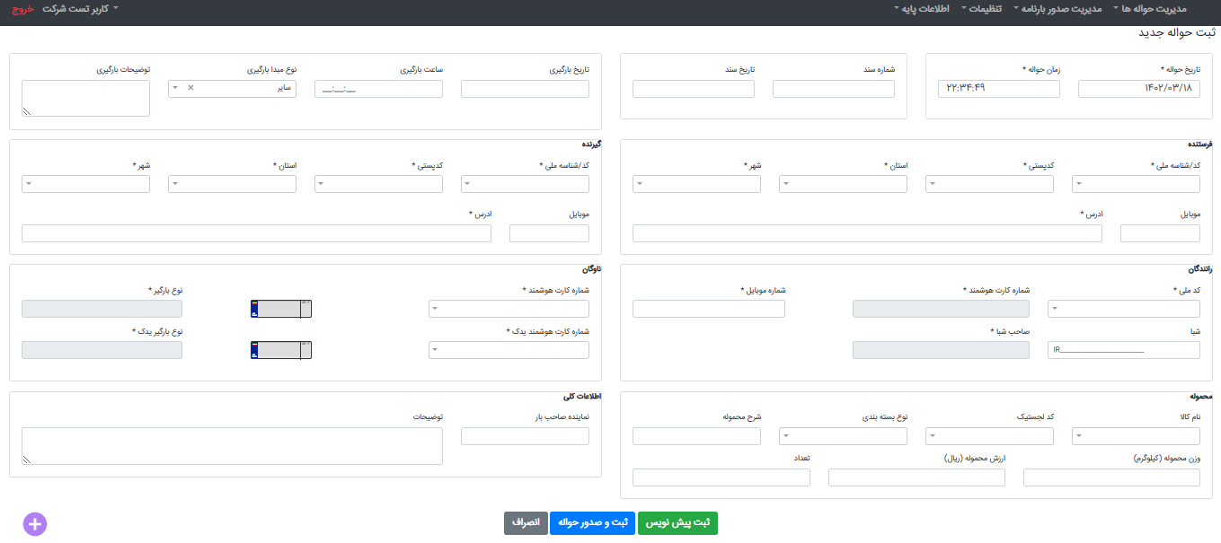
3

Slide 20
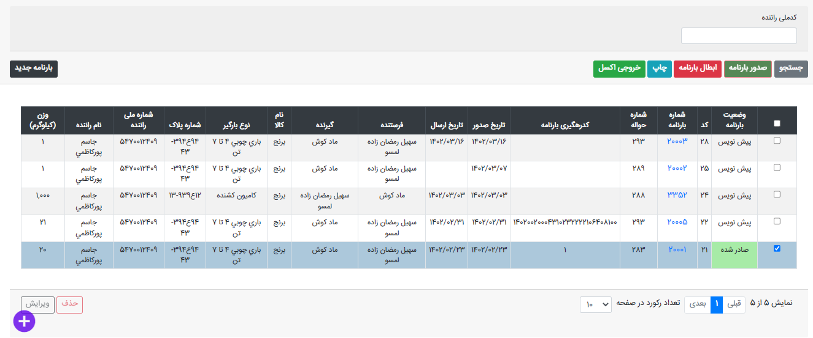
3

Slide 21
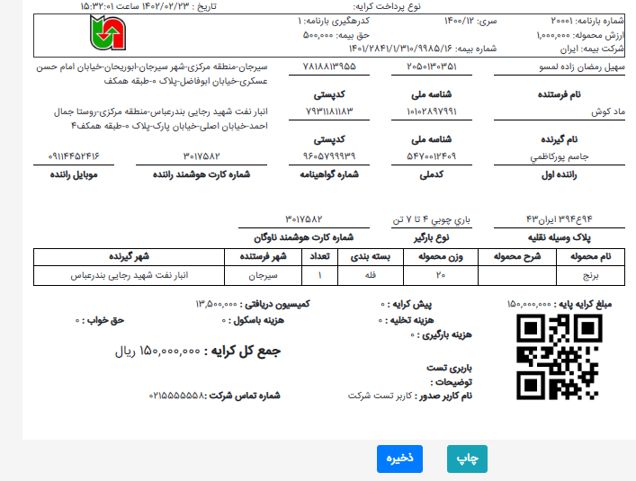
3

Slide 22
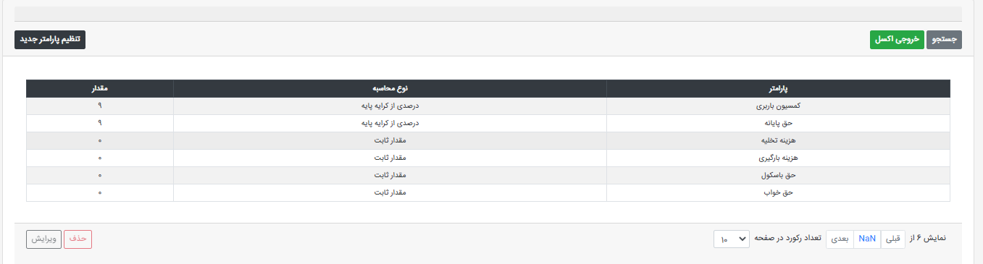
3

Slide 23
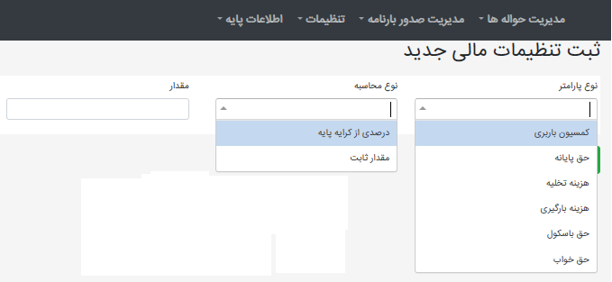
3

Slide 24
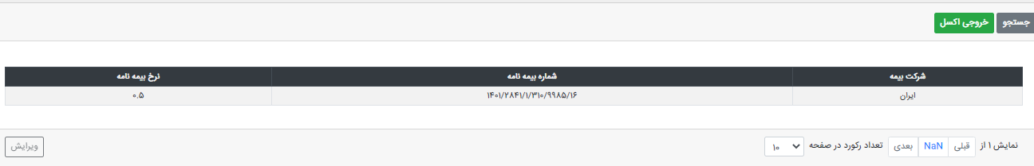
3

Slide 25
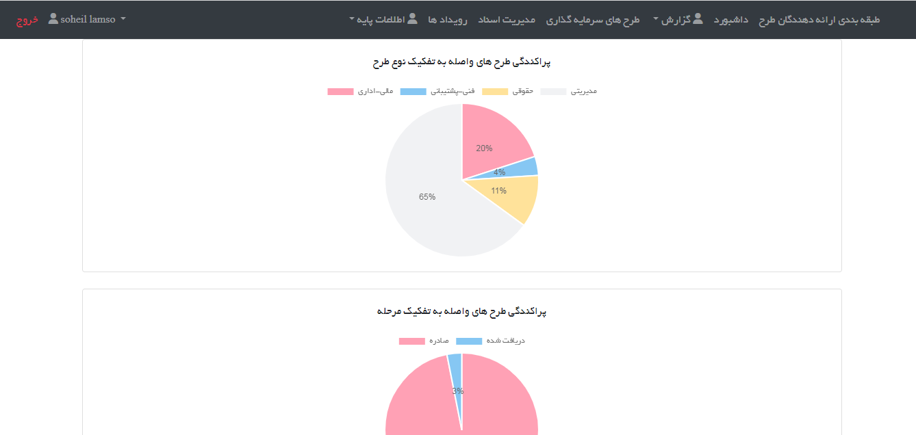
4
track.ibaar.ir
(Project management software)

Slide 26
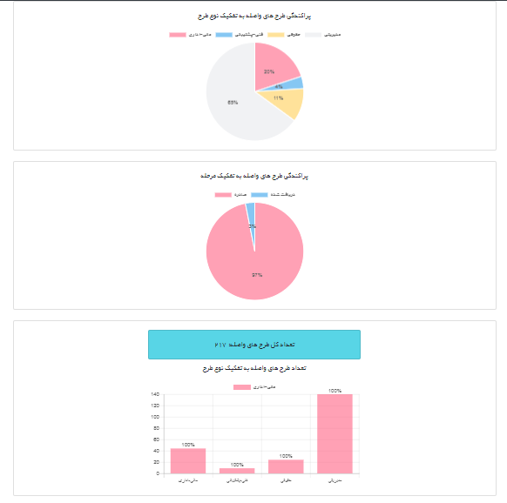
4

Slide 27
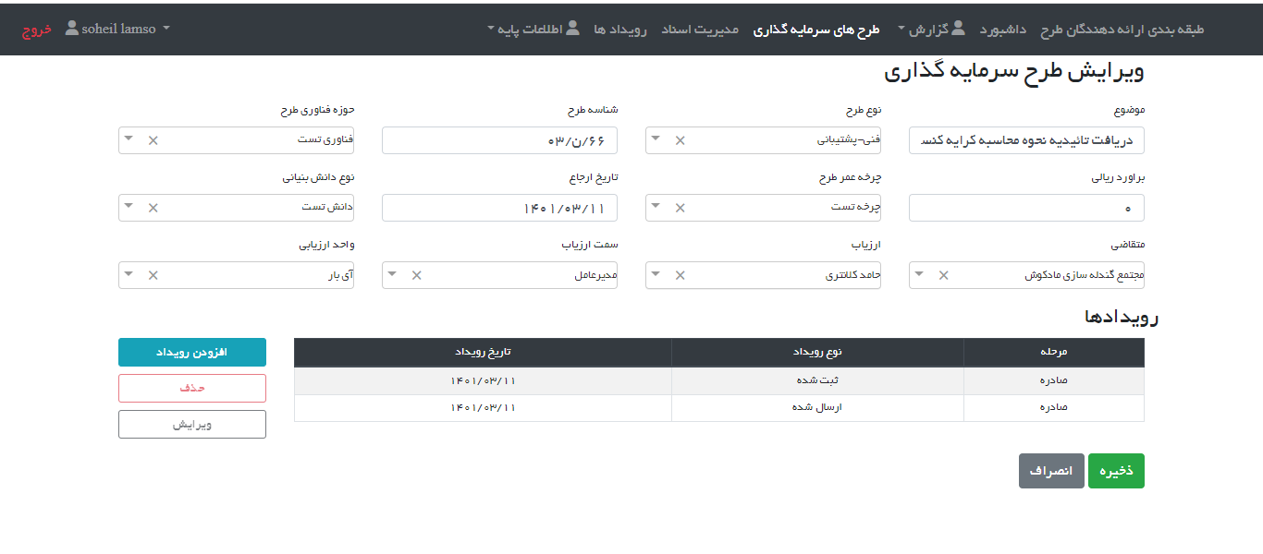
4

Slide 28
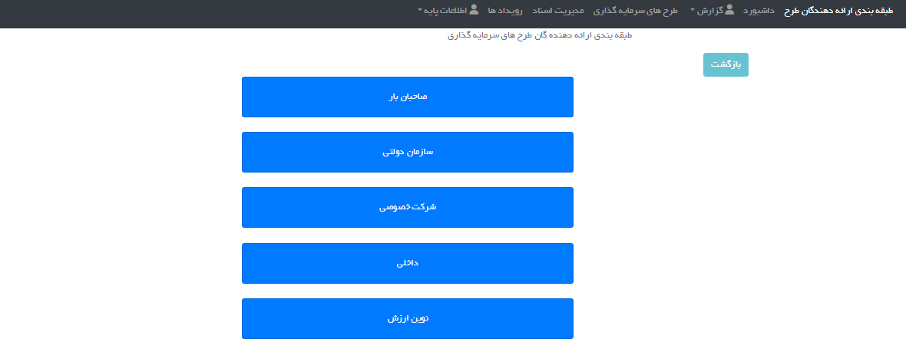
4

Slide 29
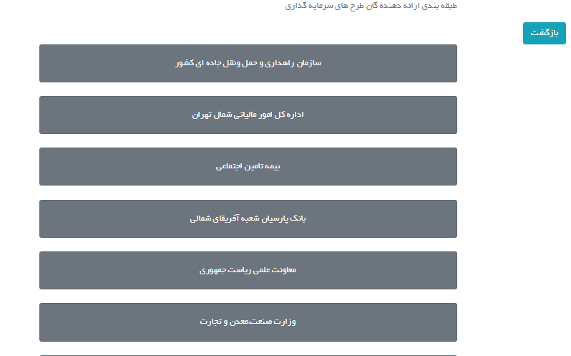
4

Slide 30
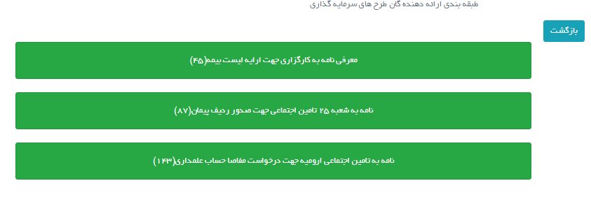
4

Slide 31
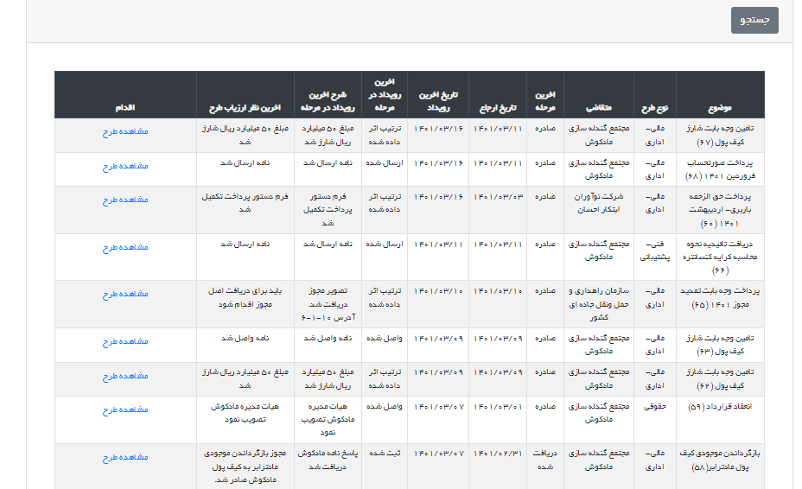
4

Slide 32
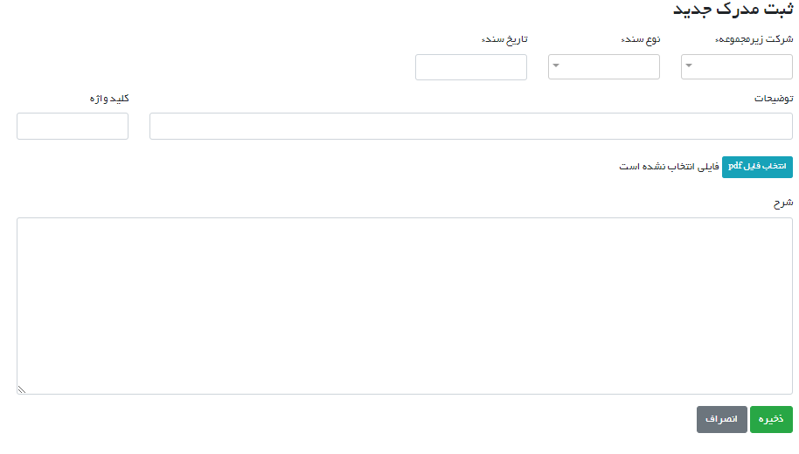
4

Slide 33
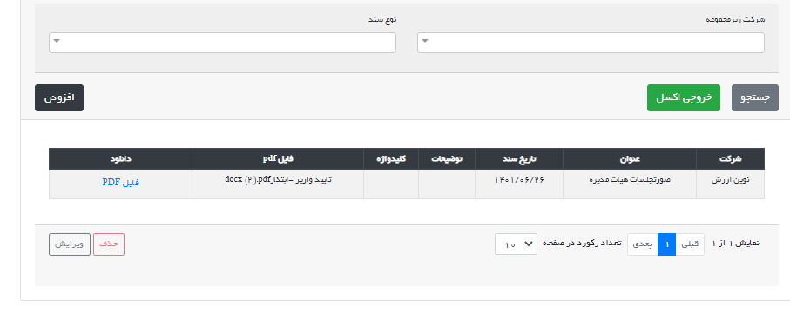
4

Slide 34
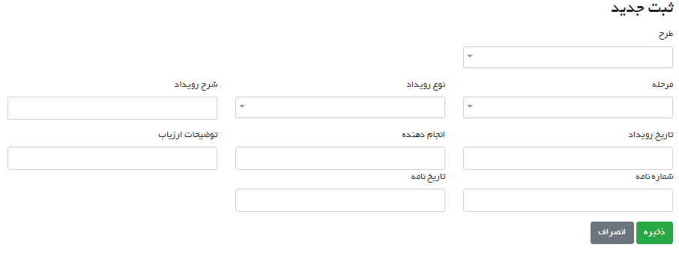
4

Slide 35
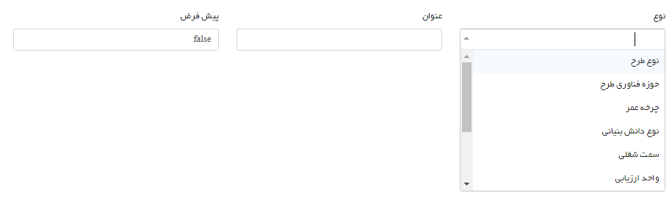
4

Slide 36
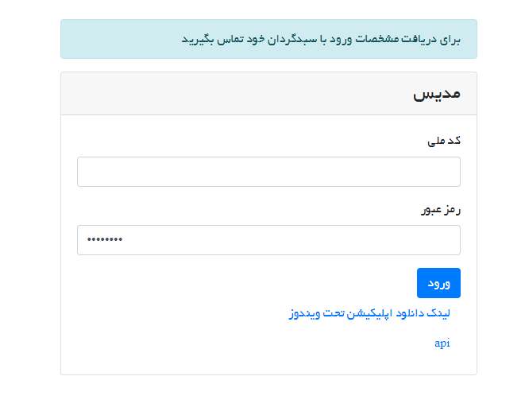
5
Modis: Capital management software - web

Slide 37
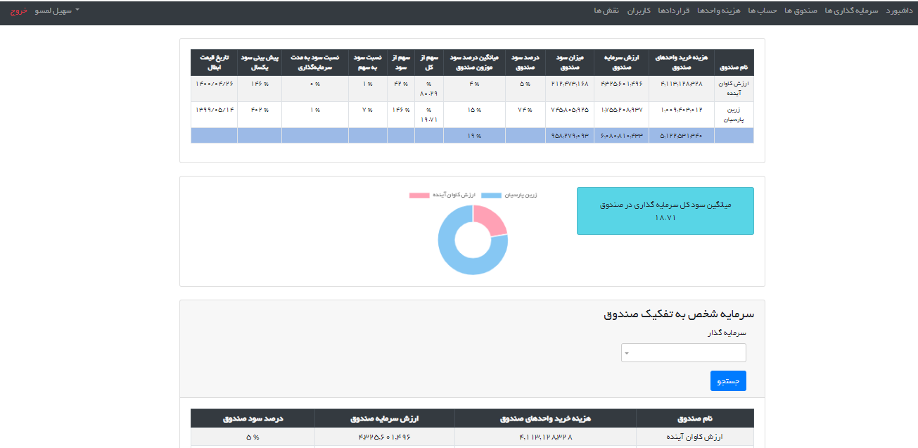
5

Slide 38
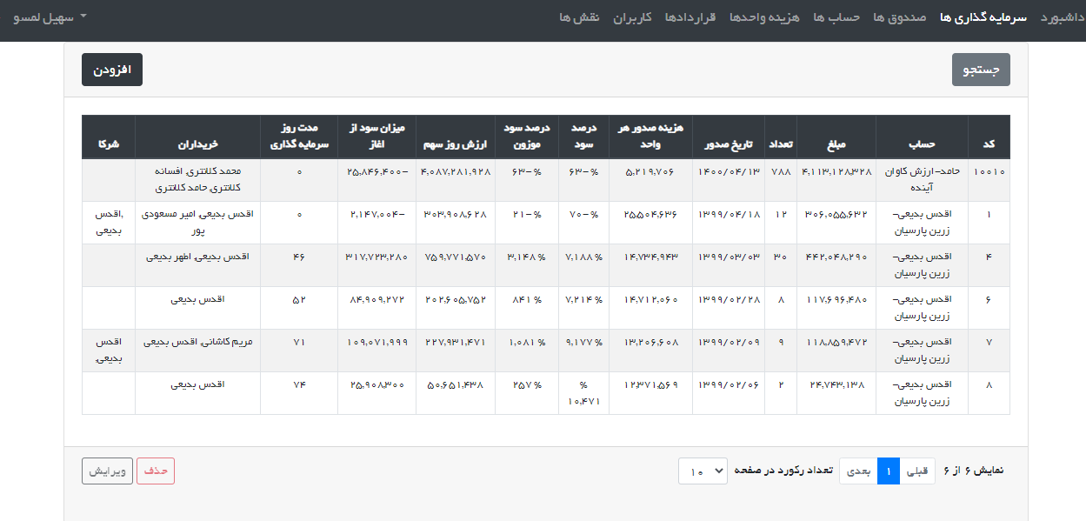
5

Slide 39
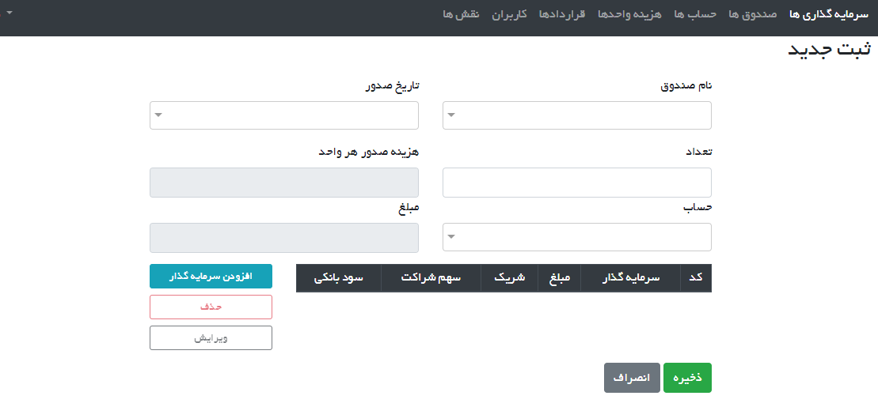
5

Slide 40
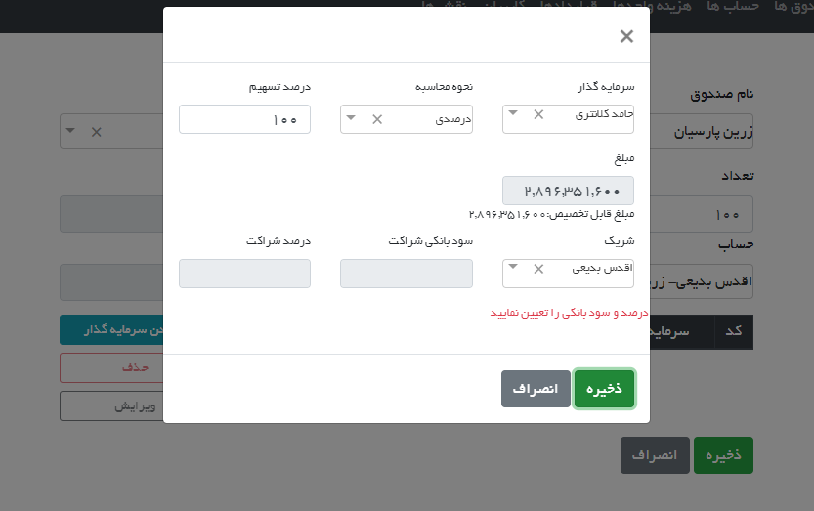
5

Slide 41
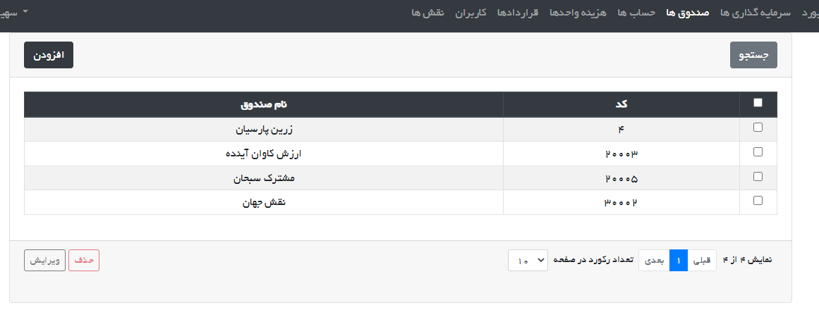
5

Slide 42
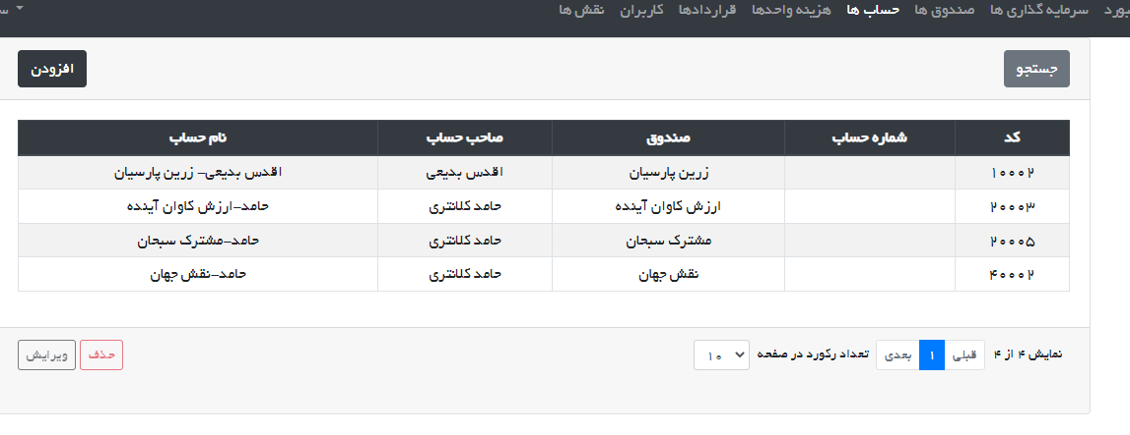
5

Slide 43
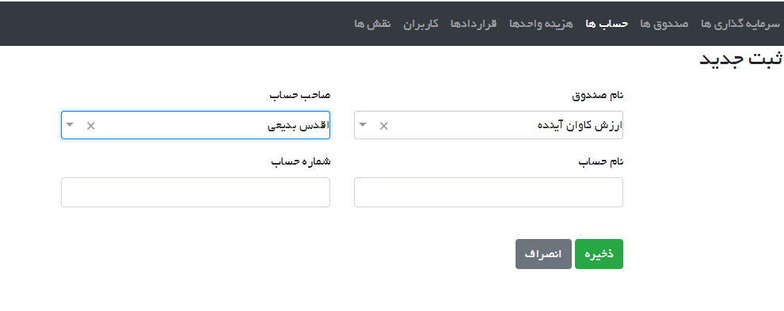
5

Slide 44
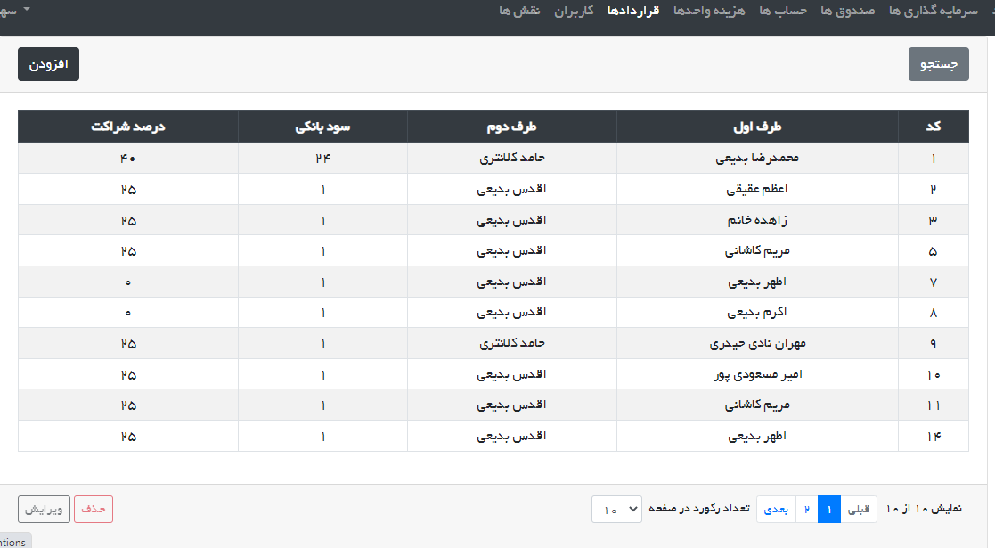
5

Slide 45
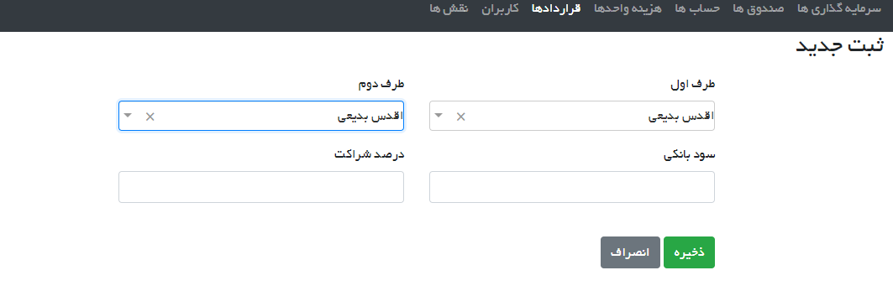
5

Slide 46
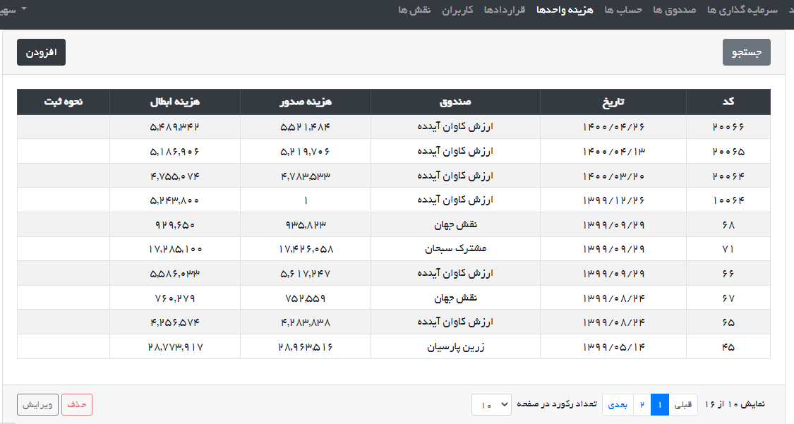
5

Slide 47
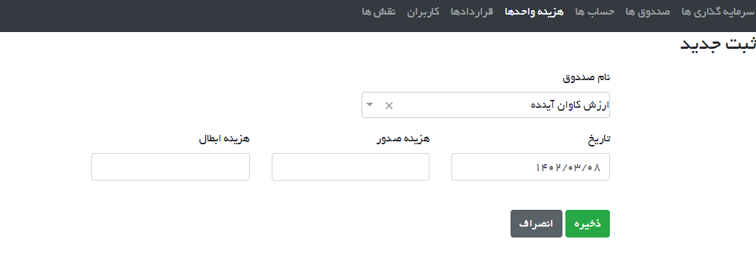
5

Slide 48
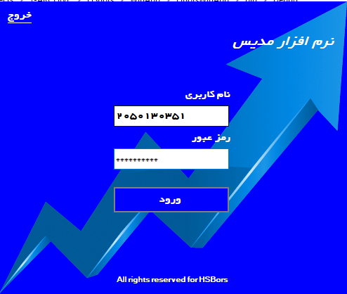
6
Modis: Capital management software - windows

Slide 49
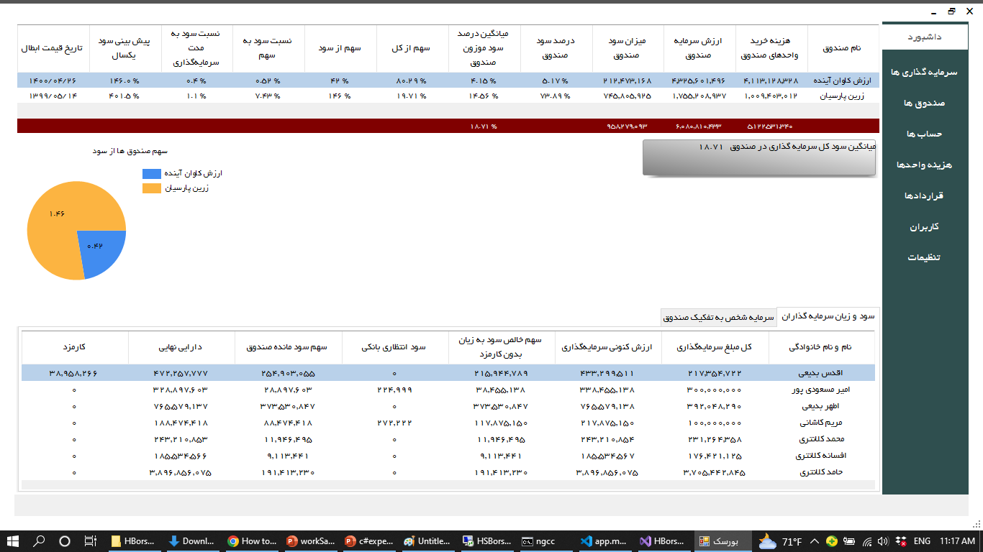
6

Slide 50
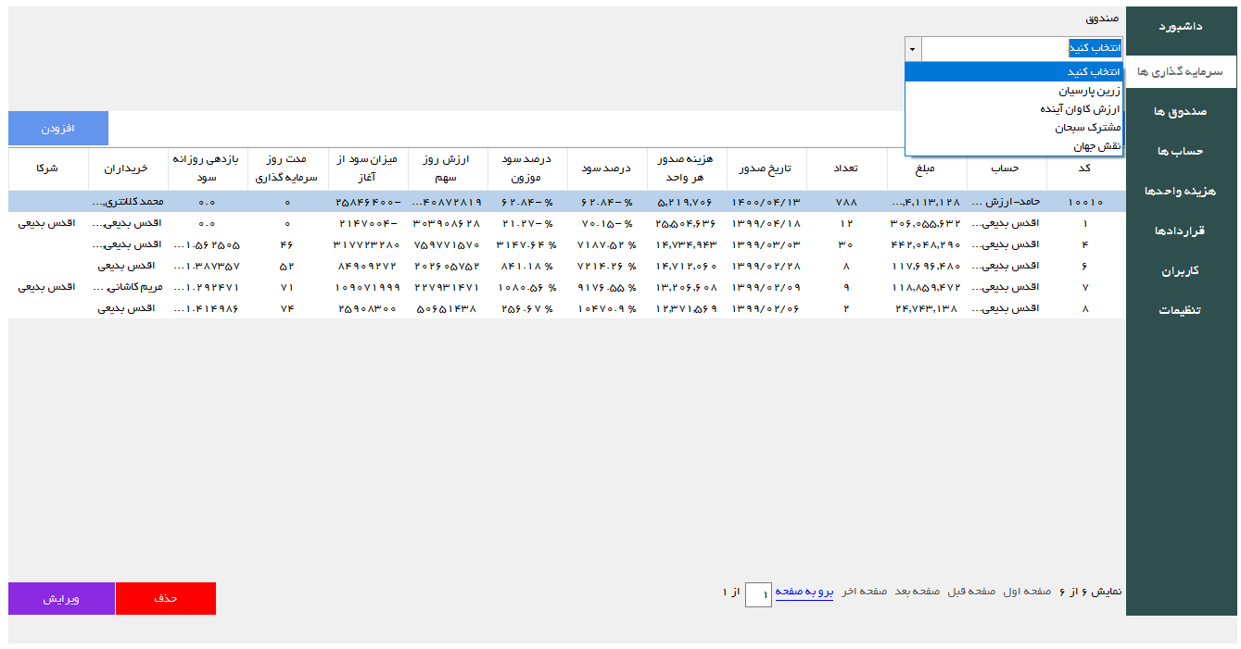
6

Slide 51
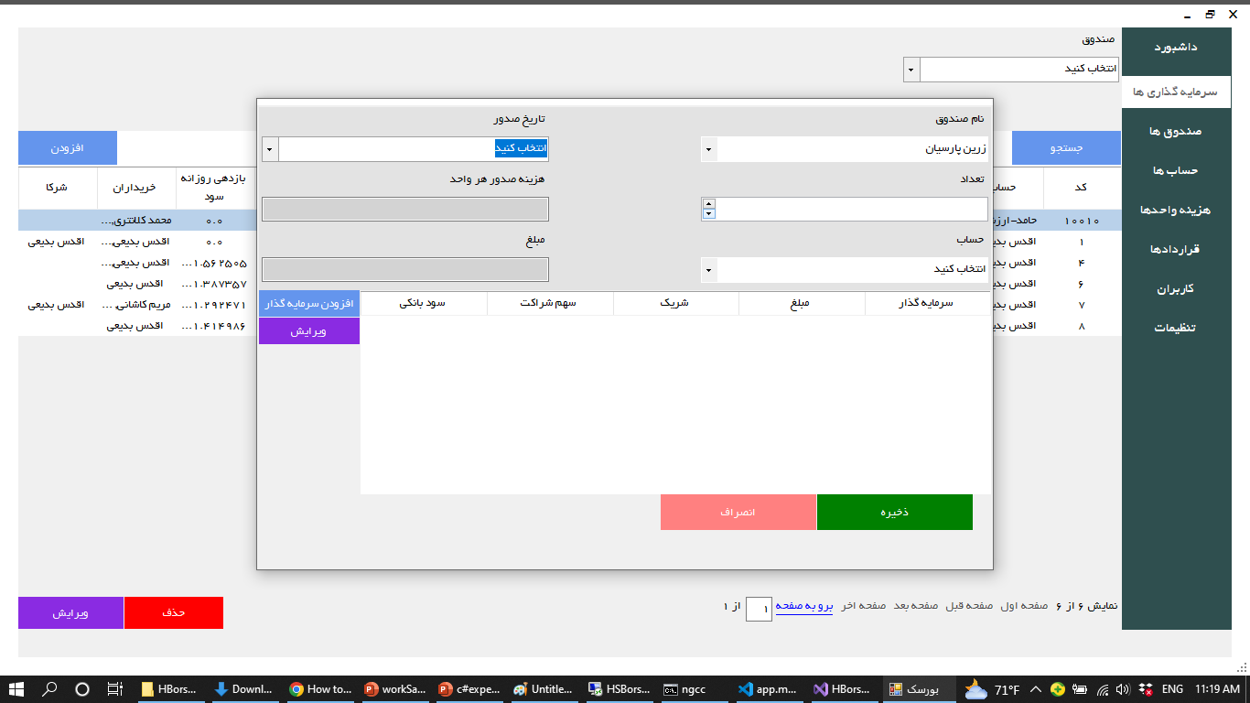
6

Slide 52
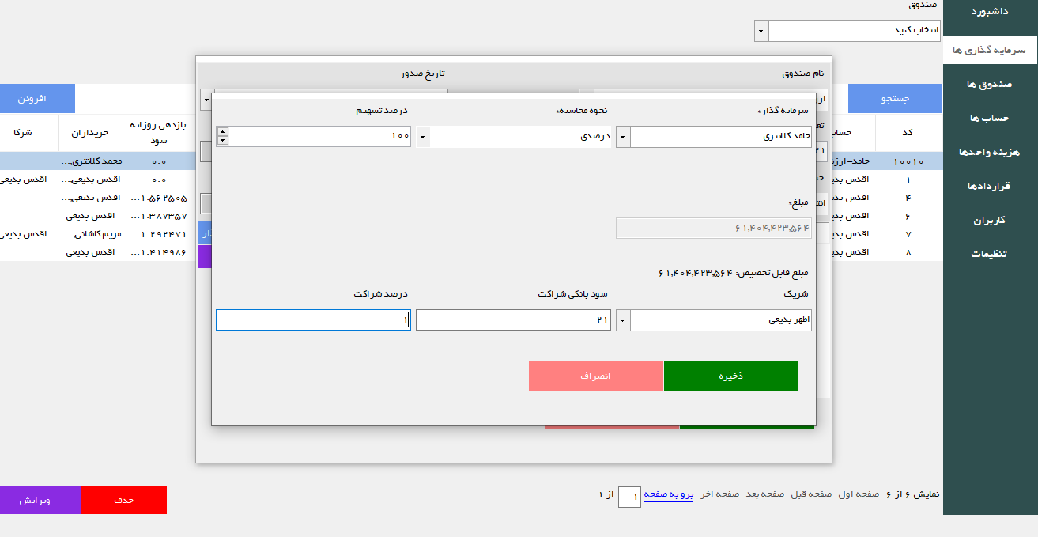
6

Slide 53

6

Slide 54

6

Slide 55

6

Slide 56

6

Slide 57

6

Slide 58

6

Slide 59

7
License Activator
(Windows application)

Slide 60

7

Slide 61

8
Eyeglass store application

Slide 62

8

Slide 63

8

Slide 64

8

Slide 65

8

Slide 66
The End

